Slide 1
Real-Time Explainable Credit Intelligence Platform
In today's rapidly evolving financial landscape, timely and transparent credit insights are paramount. This presentation outlines a groundbreaking platform designed to deliver real-time, explainable credit intelligence, addressing the critical needs of investors, credit analysts, and regulatory stakeholders.

Slide 2

AGENDA
01
02
Global Credit Market Overview
The Current Challenge
03
04
Our Solution: The Platform
Platform Architecture
05
06
Innovation Highlights
Expected Impact
07
08
Future Scope & Vision
Conclusion & Q&A

Slide 3
AGENDA
Navigating the Credit Landscape
This presentation will guide you through the current state of global credit markets, the limitations of traditional approaches, and how our innovative platform provides a superior solution for dynamic credit intelligence.
01
02
03
The Global Credit Context
Challenges with Traditional Agencies
The Need for Speed & Transparency
Understanding the complexities and rapid shifts in today's credit markets.
Why real-time, explainable insights are critical for informed decisions.
Identifying the key limitations of existing credit rating methodologies.
04
05
Our Innovative Solution
Impact & Future Scope
Introducing the core components and architecture of our platform.
Exploring the benefits for stakeholders and our vision for the future.

Slide 4

GLOBAL CREDIT MARKETS
A Landscape of Constant Change
The global credit market is a dynamic and interconnected ecosystem, characterized by rapid shifts, geopolitical influences, and technological advancements. In this environment, maintaining a clear and current understanding of credit risk is not just an advantage, but a necessity for all stakeholders.
Volatility & Complexity: Markets react instantly to geopolitical events, economic indicators, and corporate news, creating an intricate web of dependencies.
Interconnectedness: A credit event in one region can rapidly ripple across global portfolios due to interconnected financial systems.
Data Explosion: The sheer volume and velocity of financial data, from traditional reports to alternative sources, is overwhelming traditional analysis methods.
Navigating this landscape requires more than just historical data; it demands real-time intelligence that can adapt to unfolding events.

Slide 5
THE CHALLENGE
Limitations of Traditional Rating Agencies
Despite their foundational role, traditional credit rating agencies often struggle to keep pace with the modern market's demands, presenting significant challenges for investors and regulators.
Slow Updates
Lack of Transparency
Lagging Behind Events
Ratings are often backward-looking, based on lagging financial statements and quarterly reports, failing to capture real-time market shifts or emerging risks.
The methodologies behind rating assignments can be opaque, making it difficult for users to understand the underlying rationale or adapt models based on specific risk appetites.
By the time a rating change occurs, the market may have already priced in the new information, leading to missed opportunities or unexpected losses for investors.
This inherent latency and lack of granularity in traditional models highlight a critical need for a more agile and insightful credit intelligence solution.

Slide 6

OUR SOLUTION
Why Real-Time & Explainable Matters
The demand for credit intelligence that is both timely and transparent is no longer a luxury, but a fundamental requirement for navigating today's complex financial environment.
Actionable Insights: Real-time data allows for proactive risk management and timely investment decisions, enabling stakeholders to respond to events as they unfold.
Enhanced Trust: Explainable AI provides clarity on why a particular rating or score was assigned, fostering trust and enabling better internal model validation and regulatory compliance.
Competitive Edge: Faster access to granular insights offers a significant advantage in identifying emerging opportunities and mitigating risks before they become widespread.
Regulatory Imperative: Regulators increasingly emphasize transparency and robustness in risk assessment models, making explainability a key requirement for compliance.
Our platform is built to deliver on these critical needs, bridging the gap between traditional lagging indicators and dynamic market realities.

Slide 7



PLATFORM ARCHITECTURE
The Engine of Credit Intelligence
Our Real-Time Explainable Credit Intelligence Platform is built on a robust, scalable architecture designed for continuous data processing and insightful analysis.
Data Ingestion Pipeline
Adaptive Scoring Engine
Explainability Layer
Gathers vast amounts of structured and unstructured data from diverse sources, including financial reports, market data, news feeds, and earnings call transcripts.
Leverages advanced machine learning models to process data in real-time, dynamically adjusting credit scores and risk indicators based on the latest information.
Provides clear, human-readable explanations for every credit score and risk assessment, detailing the key factors and data points influencing the outcome.
This integrated approach ensures not only timely insights but also a deep understanding of the underlying drivers of credit risk.

Slide 8
INNOVATION HIGHLIGHTS
Beyond Traditional Analytics
Our platform introduces several key innovations that set it apart, pushing the boundaries of credit intelligence and risk assessment.
Unstructured Data Processing: Advanced Natural Language Processing (NLP) and sentiment analysis of news articles, social media, and earnings call transcripts provide invaluable qualitative insights often missed by quantitative models.
Interactive Analyst Dashboard: A highly customizable and intuitive interface allows analysts to drill down into data, explore scenarios, and visualize risk factors with unprecedented clarity.
Real-Time Updates: Continuous data streams and event-driven processing ensure that credit scores and risk profiles are updated instantly as new information becomes available.
Automated Deployment & Scaling: Cloud-native architecture enables seamless deployment and elastic scalability, adapting to varying data volumes and user demands without manual intervention.
These innovations combine to create a comprehensive and forward-looking credit intelligence ecosystem.

Slide 9



IMPACT
Transforming Stakeholder Operations
Our platform delivers tangible benefits across the credit ecosystem, empowering investors, regulators, and enterprise teams with superior intelligence.
For Investors
For Regulators
For Enterprise Teams
Faster Decisions: Capitalize on market movements with real-time risk assessments.
Enhanced Oversight: Monitor systemic risk with transparent, granular data.
Streamlined Operations: Automate credit analysis, freeing up valuable human capital.
Reduced Exposure: Proactively mitigate risks before they impact portfolios.
Improved Compliance: Validate internal models with explainable AI outputs.
Data-Driven Strategy: Inform product development and engineering with deep market insights.

Slide 10
FUTURE SCOPE
Evolving Credit Intelligence
Our vision extends beyond current capabilities, with a roadmap focused on continuous innovation and expanding the reach of real-time credit intelligence.
Phase 1: Enhanced Predictive Analytics
Phase 3: Broader Asset Class Coverage
Integrating advanced predictive models for forecasting future credit trends and probabilities of default with even greater accuracy.
Expanding the platform's capabilities to cover a wider range of asset classes, including private credit, real estate, and structured finance.
1
2
3
4
Phase 2: ESG Integration
Phase 4: Blockchain & Decentralized Finance (DeFi)
Incorporating Environmental, Social, and Governance (ESG) factors into credit scoring, reflecting the growing importance of sustainable finance.
Exploring integration with blockchain technologies and DeFi protocols to offer decentralized credit risk assessment and real-time smart contract monitoring.

Slide 11
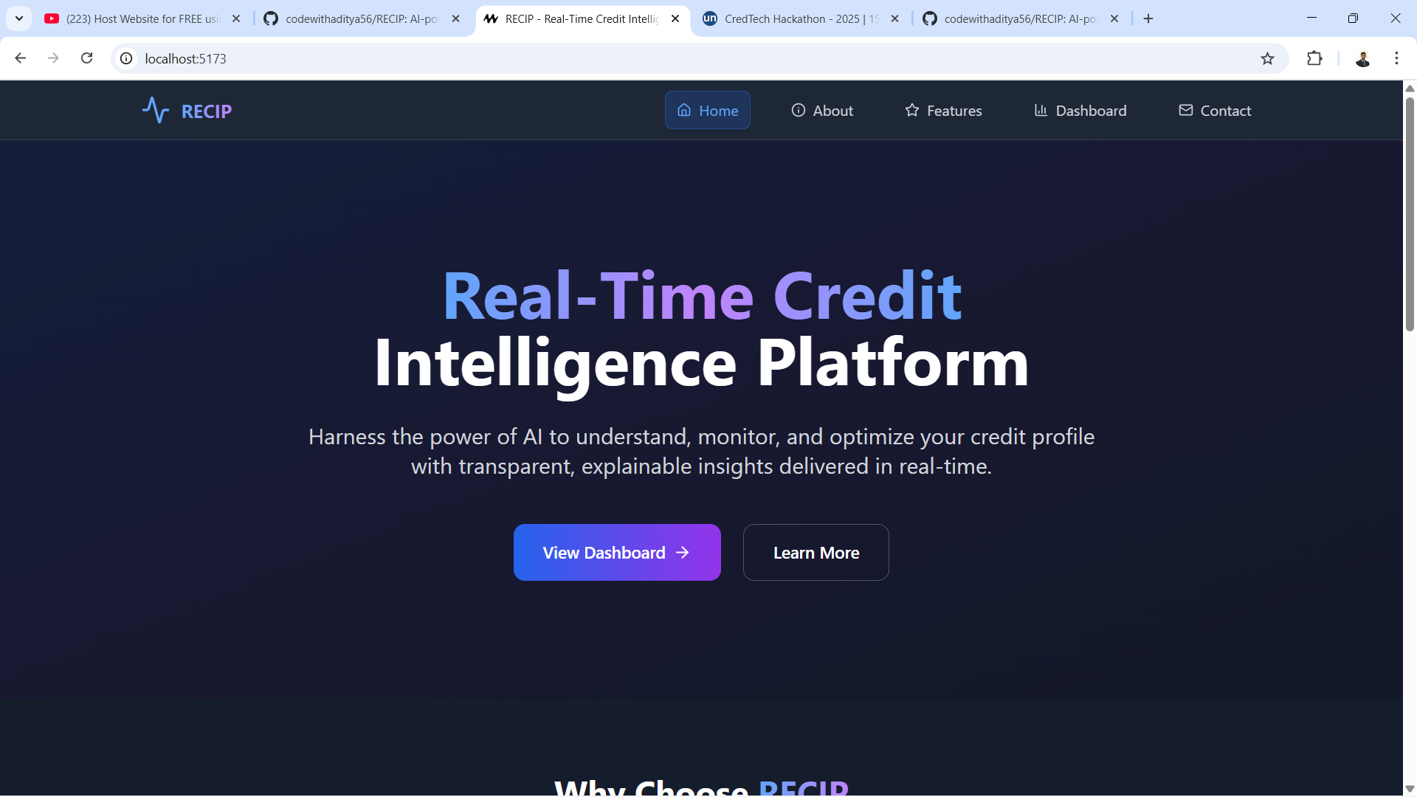
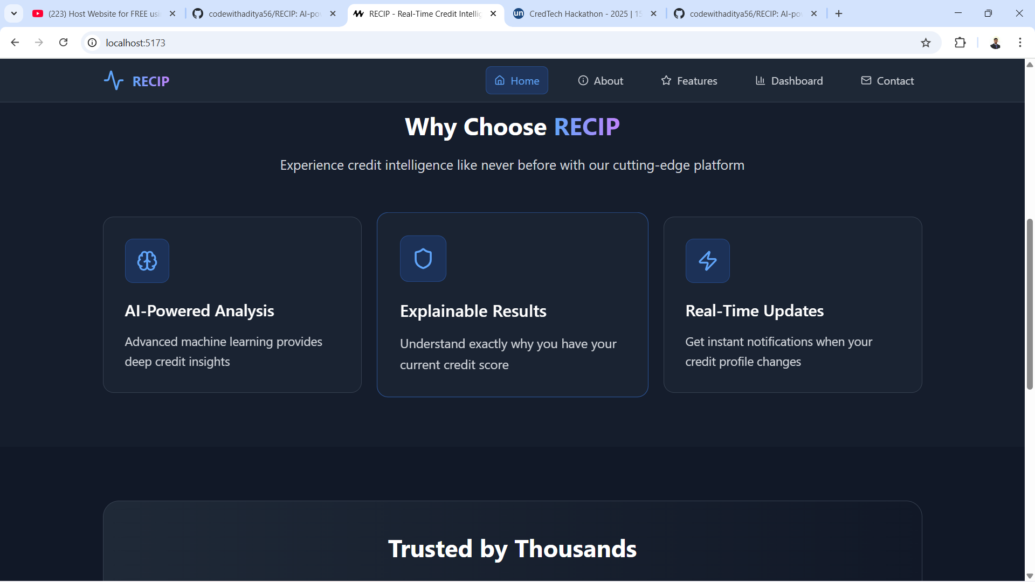
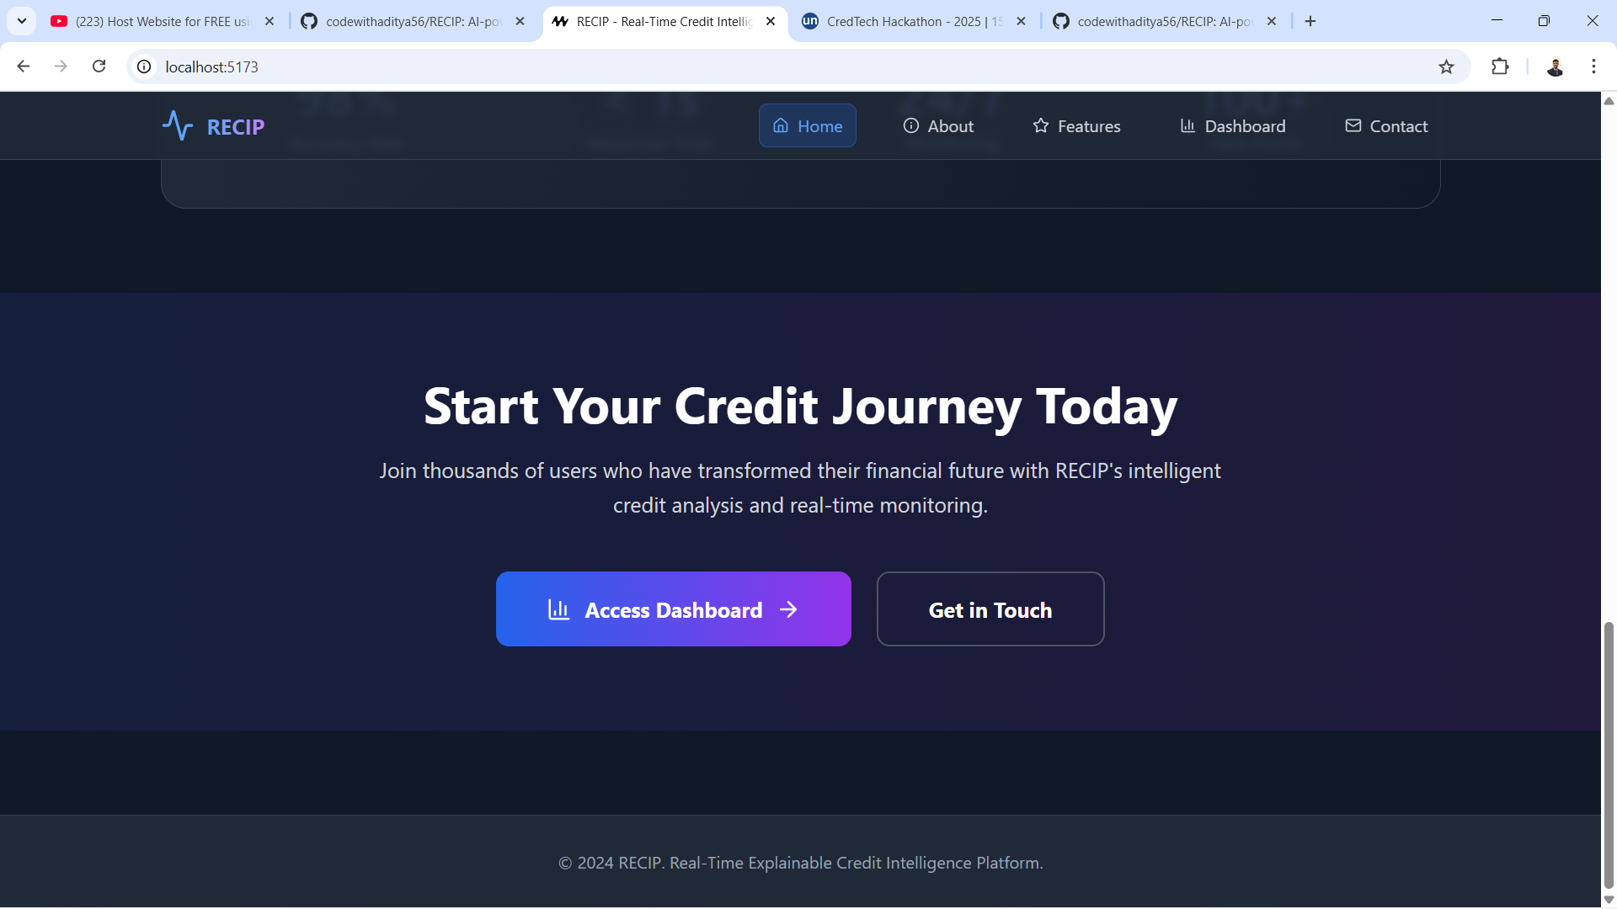
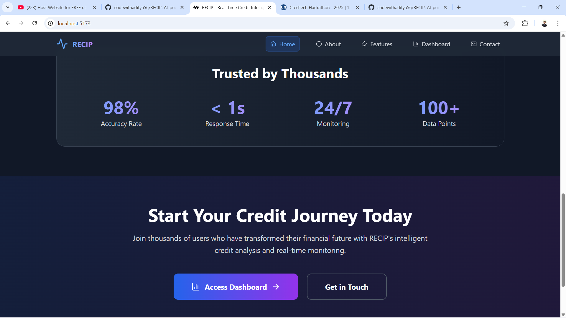

Slide 12
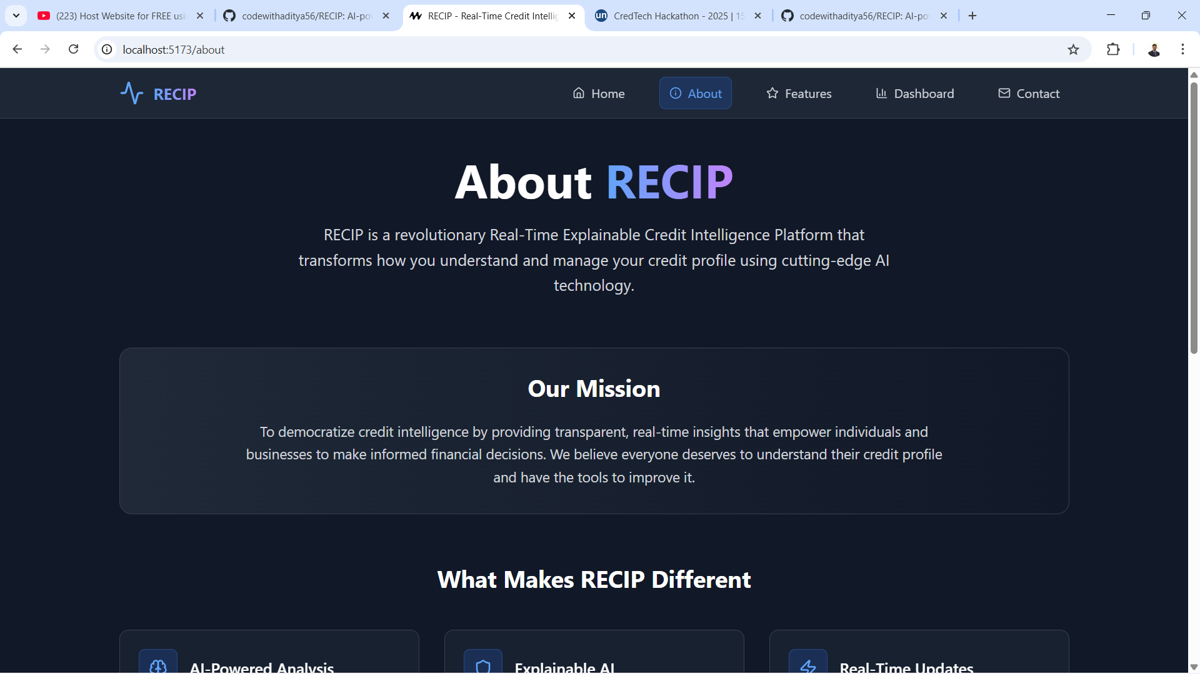
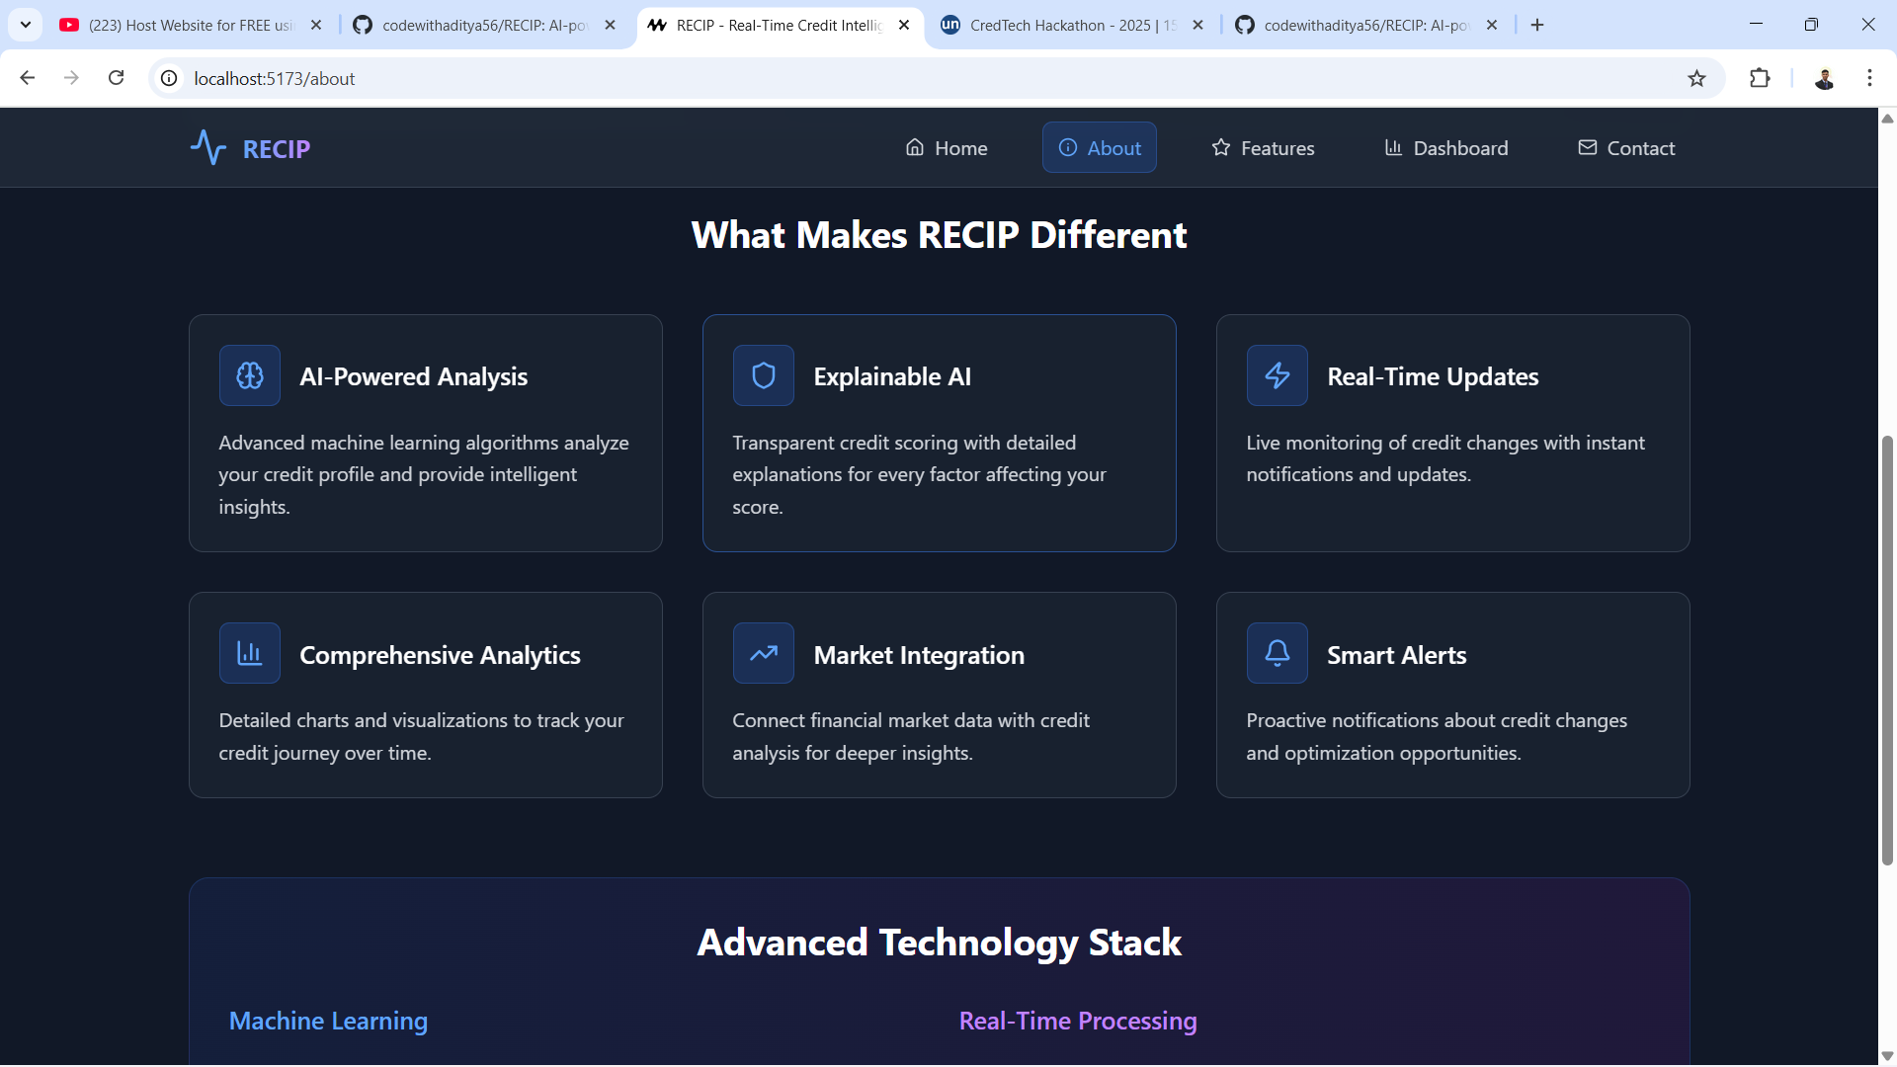
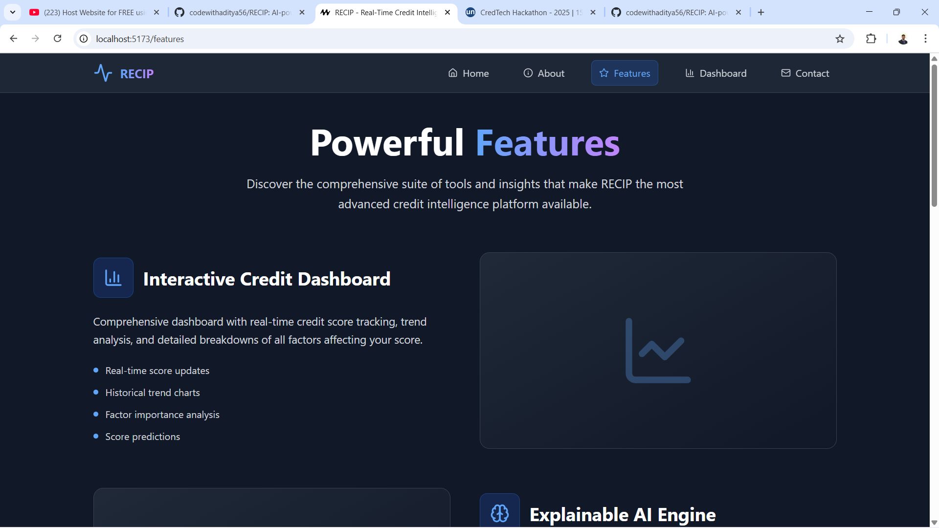
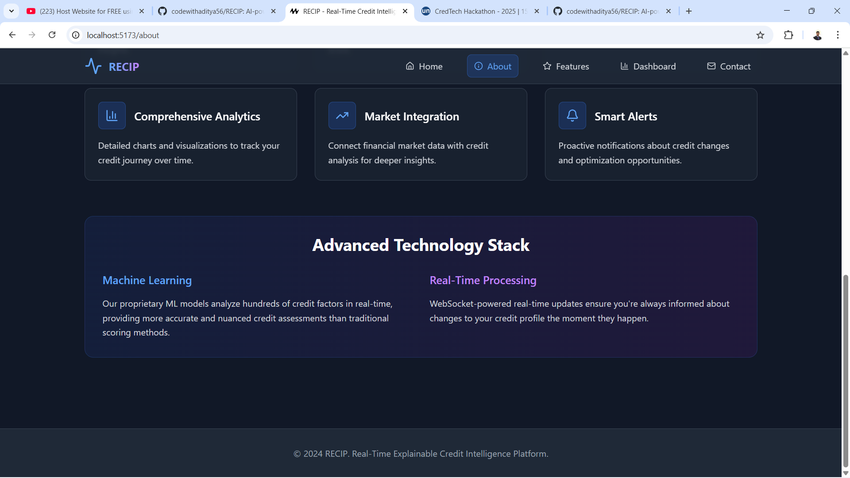

Slide 13
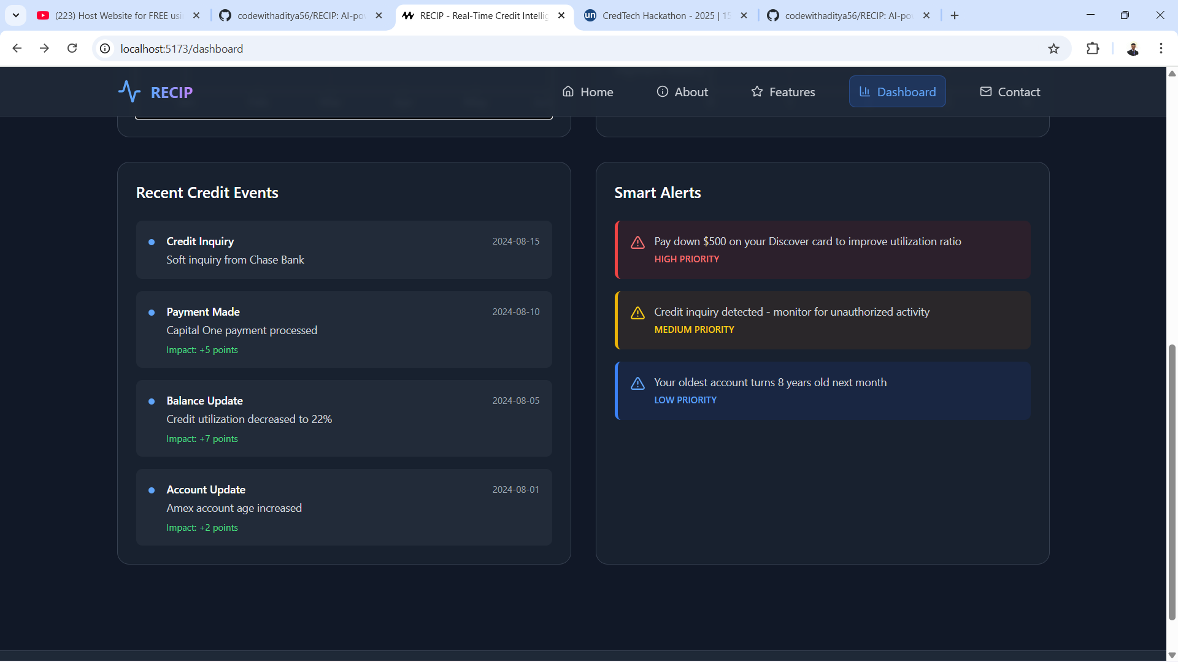
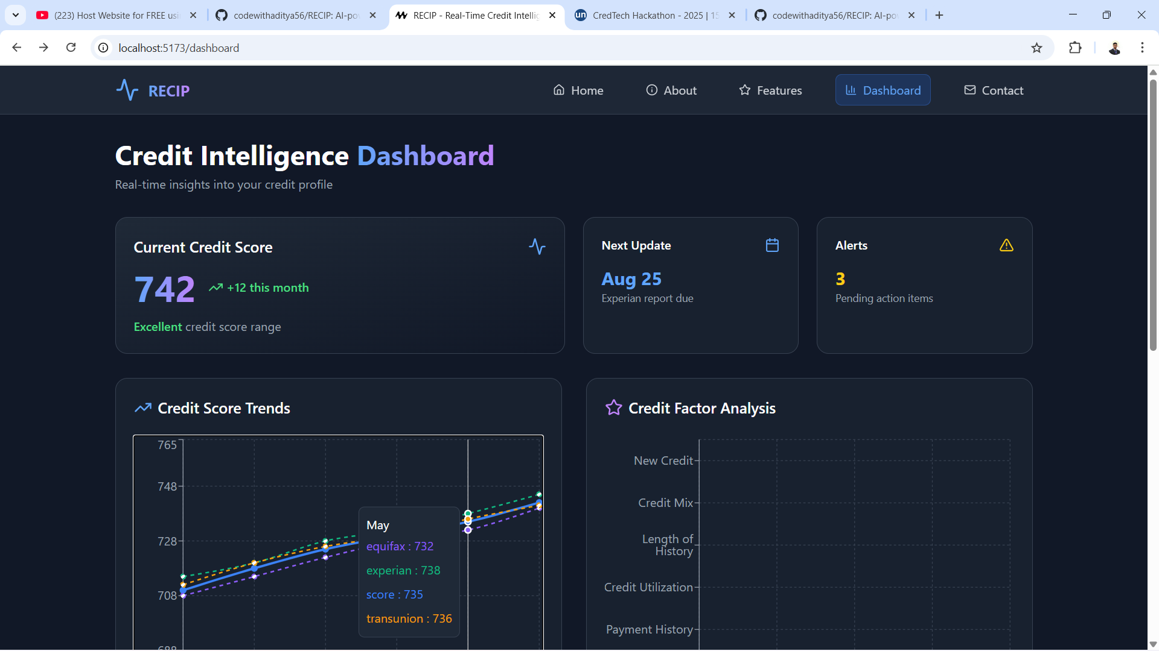
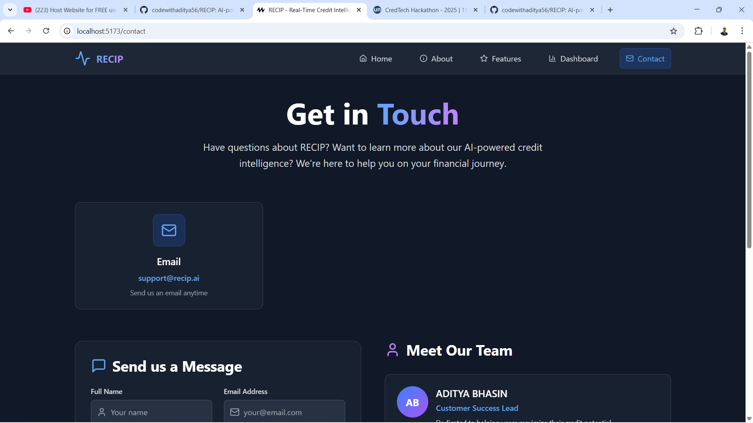
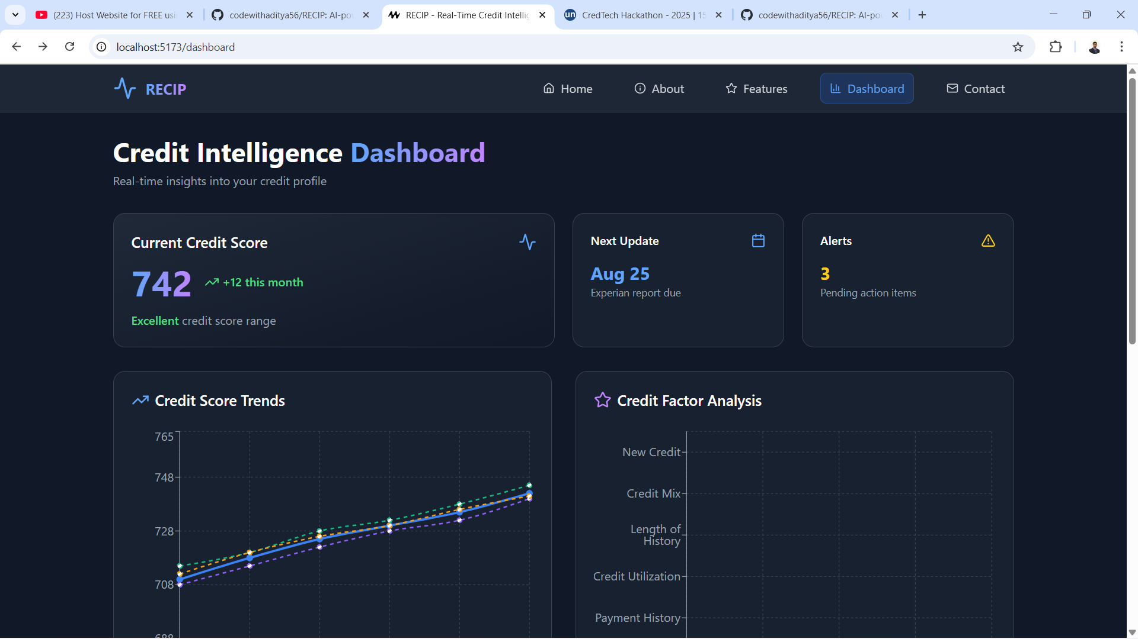

Slide 15
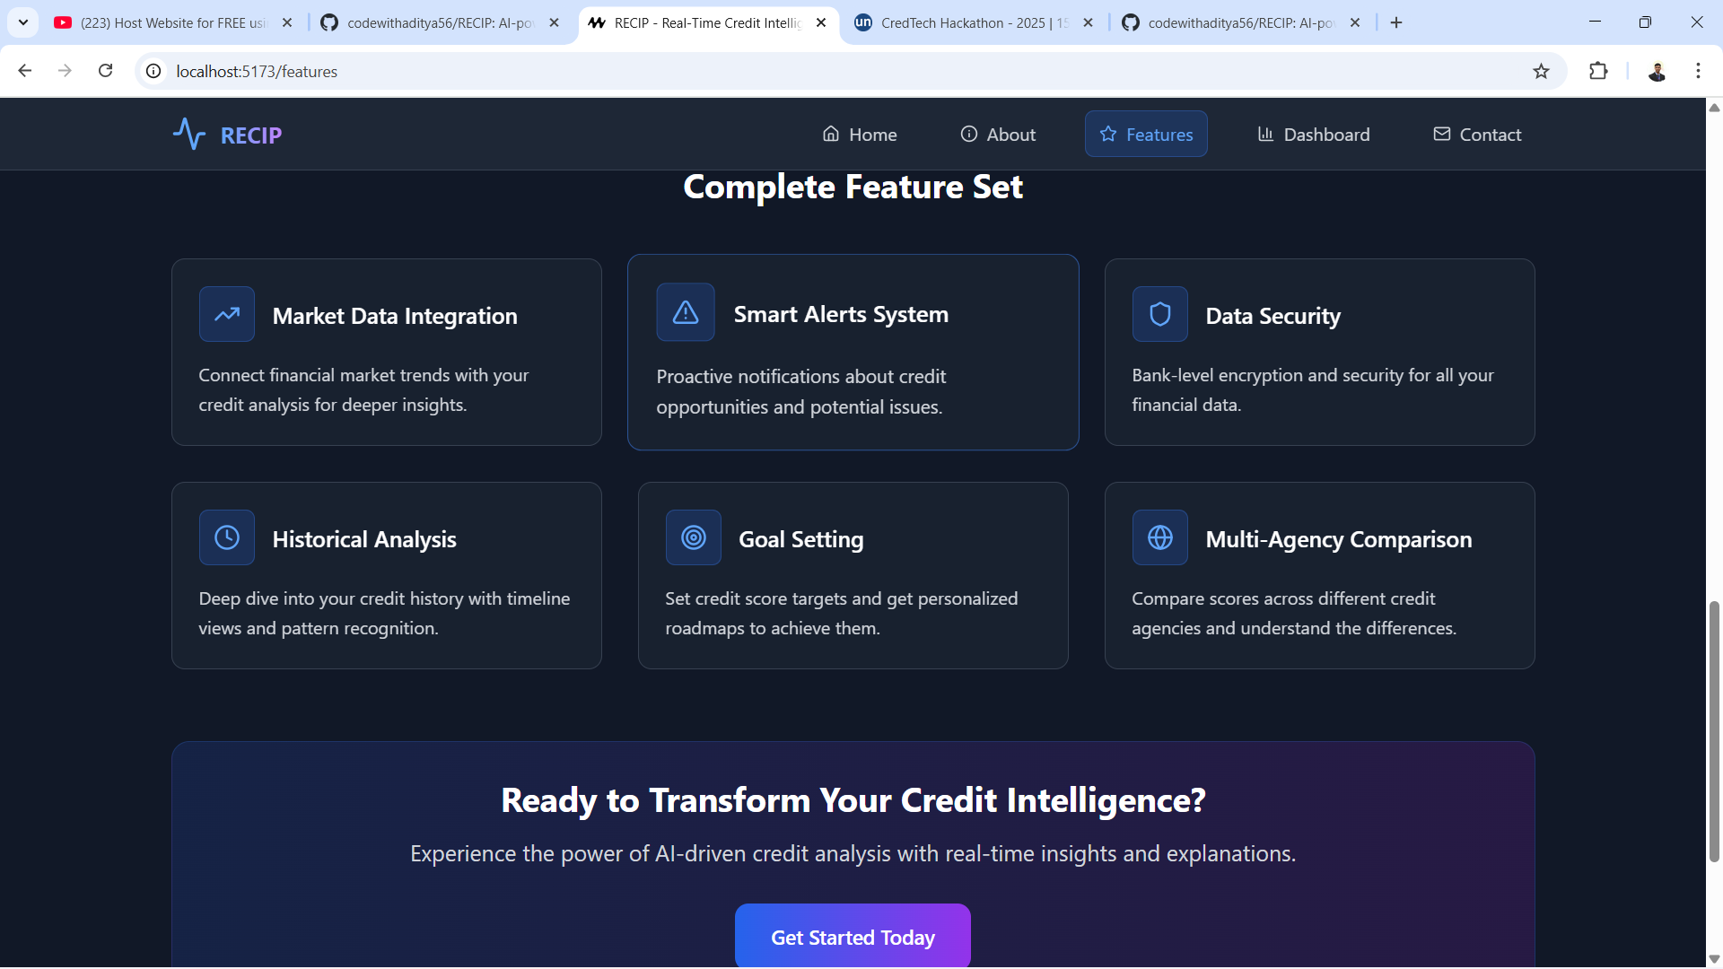
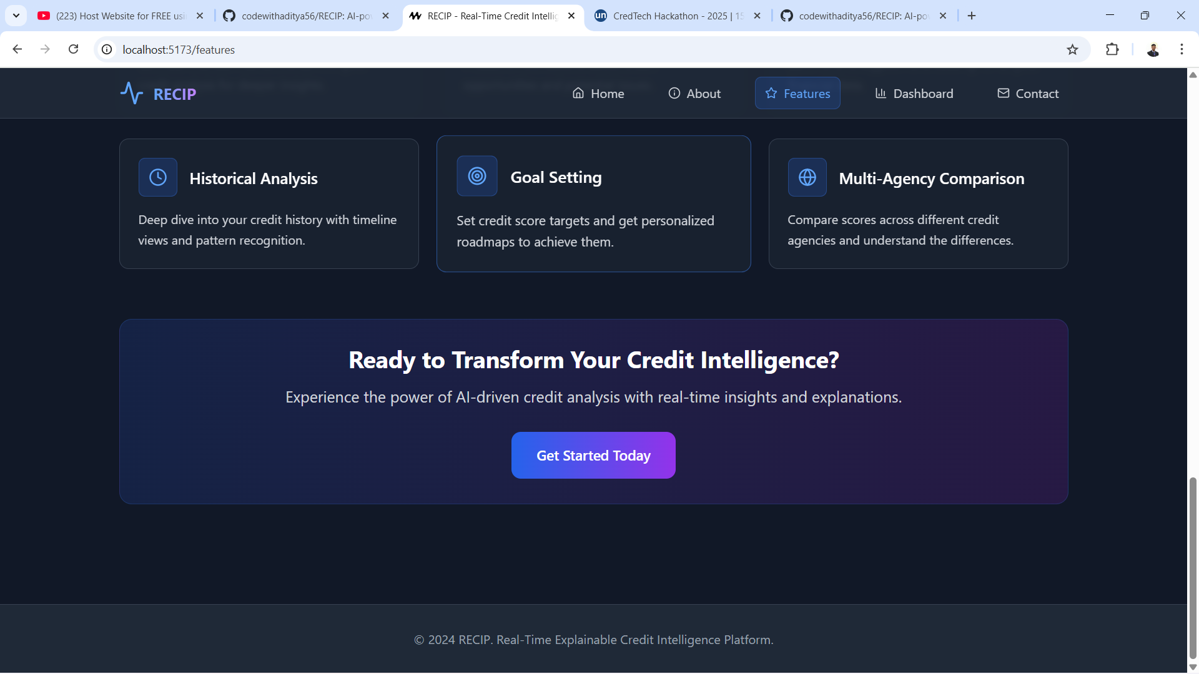
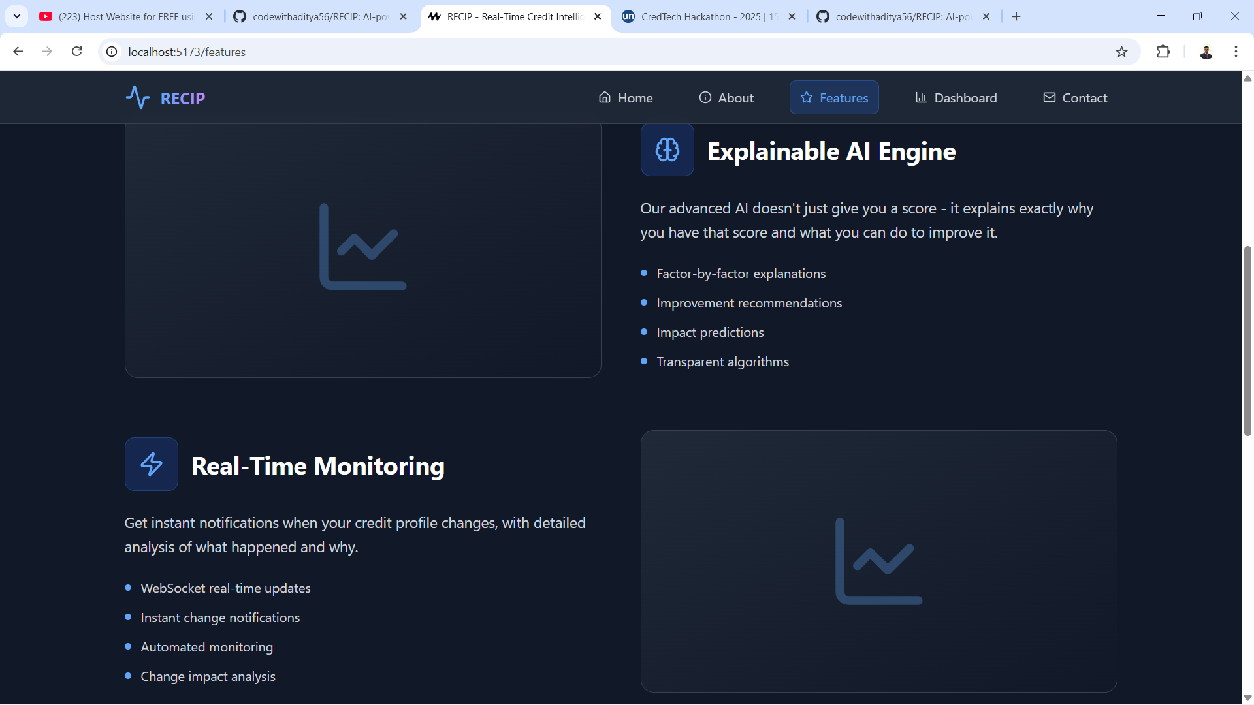
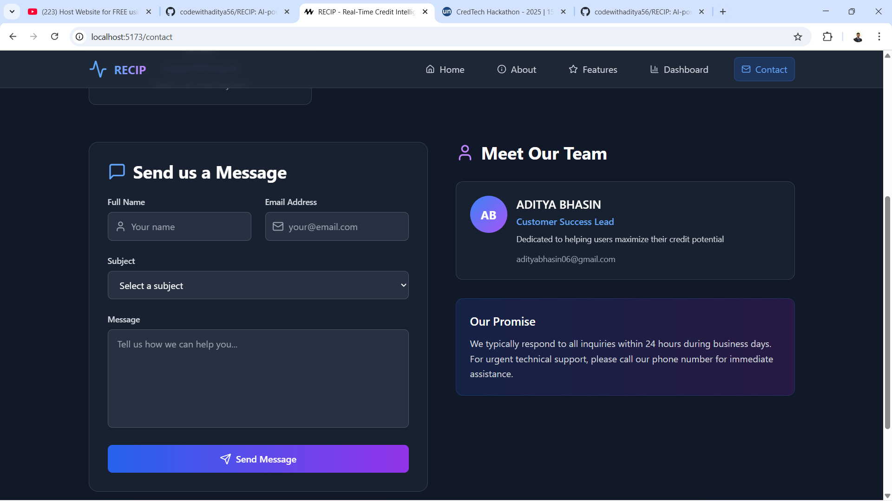

Slide 16

Conclusion
Driving the Future of Credit Intelligence
Our Real-Time Explainable Credit Intelligence Platform is more than just a tool; it's a paradigm shift in how credit risk is understood and managed. By combining speed, transparency, and advanced analytics, we empower stakeholders to make more informed decisions, navigate volatility, and seize opportunities in a rapidly changing global market.
Join us in shaping a more resilient and insightful financial future.

